Slide 1

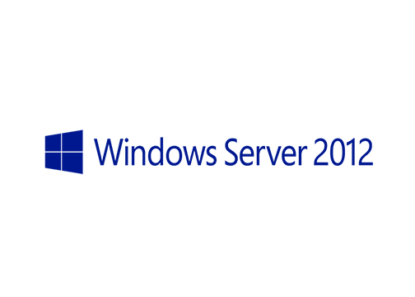
MegaSeries
Features on Demand and .NET Framework 3.5

Slide 2
Features on Demand
All Roles and Featurs files are stored on the Windows partition in C:\Windows\WinSxS (Windows side by side store)

Slide 3
Features on Demand
All Roles and Featurs files are stored on the Windows partition in C:\Windows\WinSxS (Windows side by side store)
In order to reduce disk size you can permanently remove files for roles or features that you know you will never install on a particular server

Slide 4
Features on Demand
All Roles and Featurs files are stored on the Windows partition in C:\Windows\WinSxS (Windows side by side store)
In order to reduce disk size you can permanently remove files for roles or features that you know you will never install on a particular server
In case you want to reinstall a deleted feature you can use the following sources: Windows Update, the install WIM image directly, a folder where the install WIM is mounted or a folder where the sxs folder from the WIM has been copied

Slide 5
.NET Framework 3.5
This feature is a special case as it is not included in the Windows Server 2012 image

Slide 6
.NET Framework 3.5
This feature is a special case as it is not included in the Windows Server 2012 image
To install it you can use Windows Update, the installation DVD or a folder where the feature has been copied

Slide 7
https://www.youtube.com/channel/UCcZ-jLbPwNr8E_v9-65n8Iw https://github.com/itknowledge4

